Slide 1
Randomized Algorithms CS648A
Lecture 7
Randomized Quick Sort:
Proof for the Concentration of its running time
Approximate Distance oracles

Slide 2
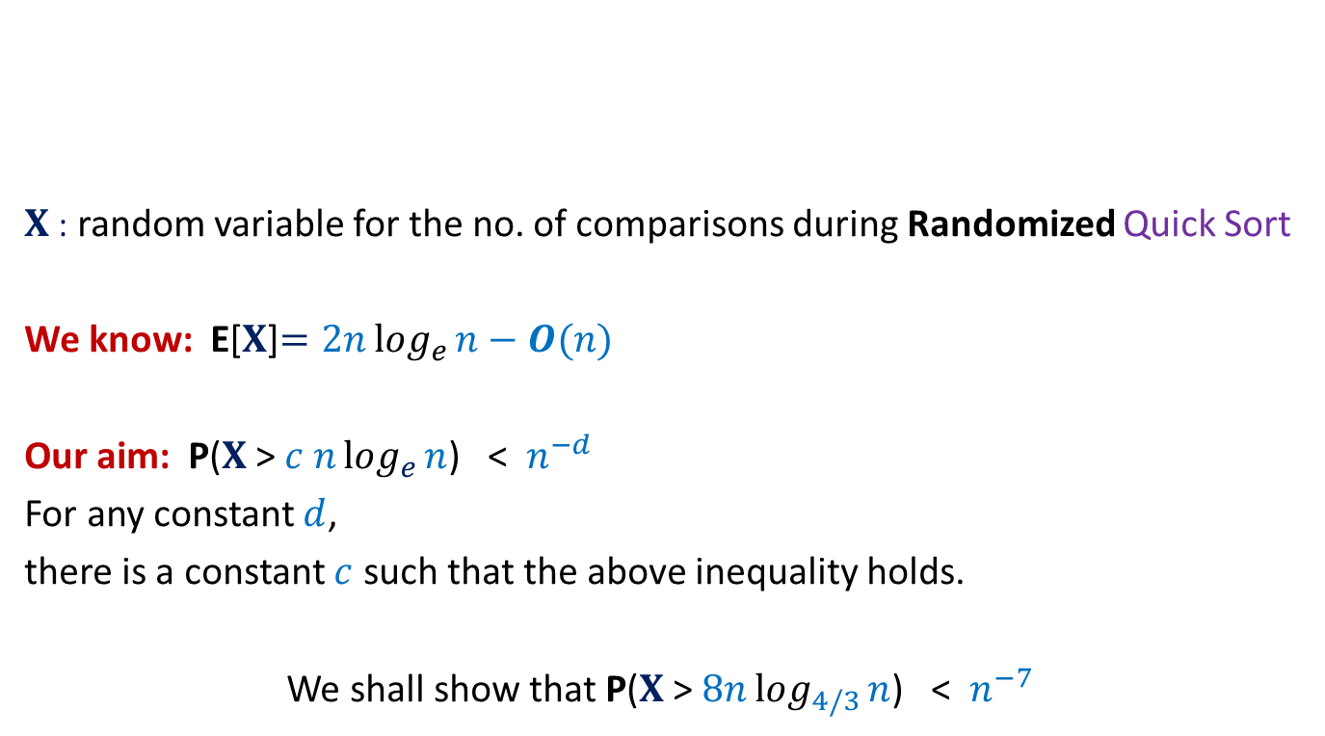


Concentration of running time of Randomized Quick Sort
$X$: random variable for the no. of comparisons during Randomized Quick Sort
We know: E[$X$]$=2nlog_{e}{n}−O(n)$
Our aim: P($X$ > $c nlog_{e}{n}$) < $n^{−d}$
For any constant $d$,
there is a constant $c$ such that the above inequality holds.
We shall show that P($X$ > $8nlog_{4/3}{n}$) < $n^{−7}$
$1$ …
$$n$$
A

Slide 3

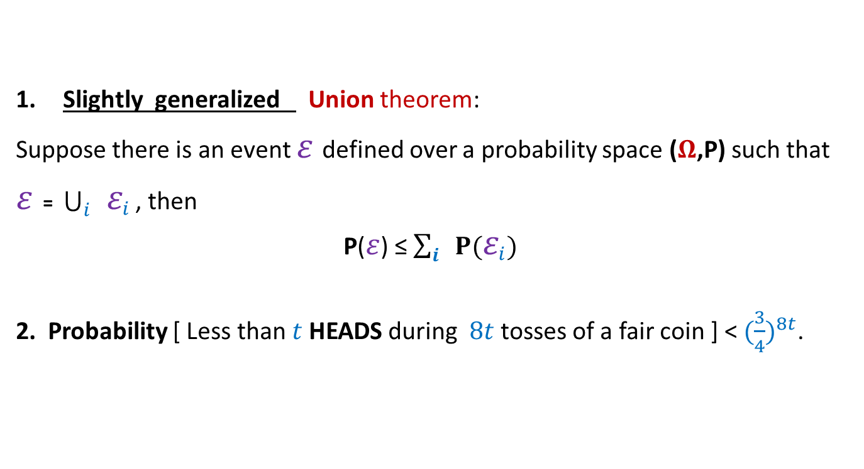
Concentration of running time of Randomized Quick Sort
Slightly generalized Union theorem:
Suppose there is an event $ε$defined over a probability space ($Ω$,P) such that
$ε$ = $\bigcup_{i}{ ε_{i}}$ , then
P($ε$) ≤ $\sum_{i}{ P(ε_{i})}$
2. Probability [ Less than $t$ HEADS during $8t$tosses of a fair coin ] < ${(\frac{3}{4})}^{8t}$.
Tools needed
$$⊆$$

Slide 4
What picture comes to your mind
when Randomized Quick sort makes too many comparisons ?

Slide 5


Recursion Tree
$n$= $25$
$$⌈log_{2}{n}⌉$$
Notes:
What picture comes to mind when Randomized Quick sort makes too many comparisons ?
Let us view the corresponding recursion tree.
There are elements in the recursion tree lying much deeper than $log_{2}{n}$
How to capture the ‘bad events’ in terms of such elements ?
Ponder over it …

Slide 6
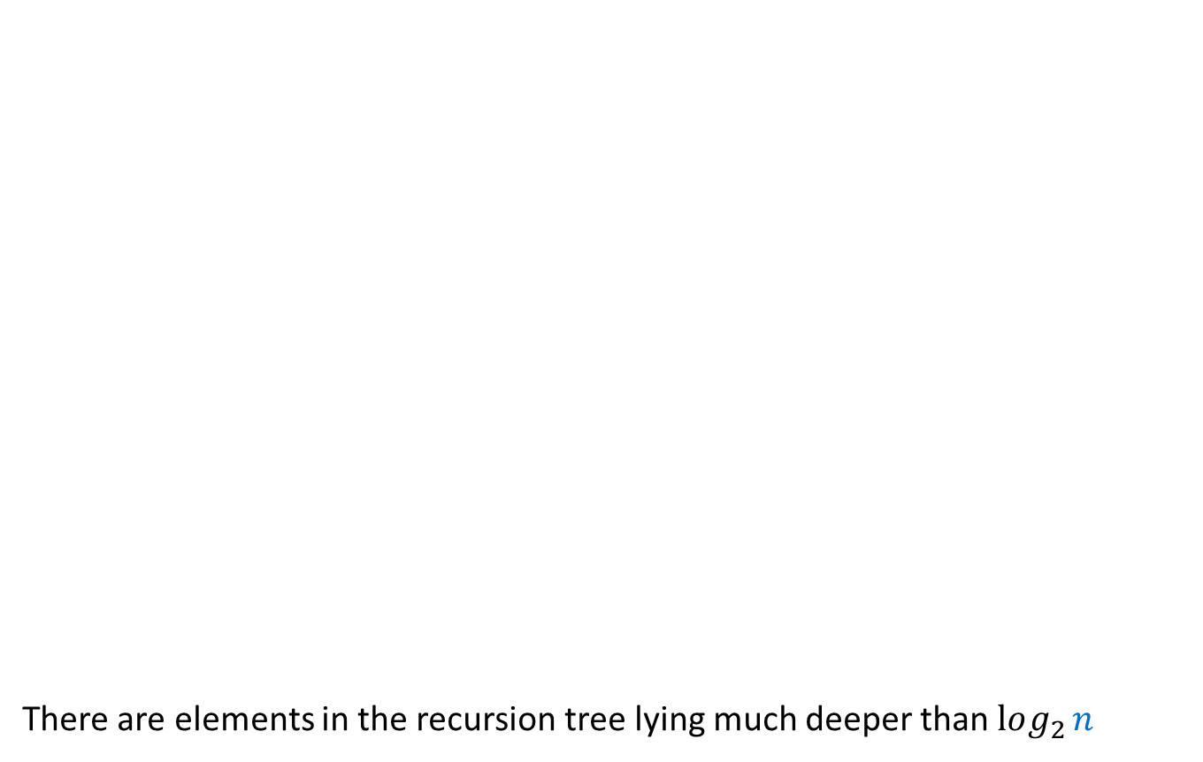
Recursion Tree
$n$= $25$
There are elements in the recursion tree lying much deeper than $log_{2}{n}$
$$⌈log_{2}{n}⌉$$
How to capture the ‘bad events’ in terms of such elements ?
Ponder over it …
Notes:
What picture comes to mind when Randomized Quick sort makes too many comparisons ?
Let us view the corresponding recursion tree.
There are elements in the recursion tree lying much deeper than $log_{2}{n}$
How to capture the ‘bad events’ in terms of such elements ?
Ponder over it …

Slide 7


Randomized Quick Sort
from perspective of $e_{i}$
Recursion Tree
$$e_{i}$$
Elements of A arranged in Increasing order of values

Slide 8

Randomized Quick Sort
from perspective of $e_{i}$
Recursion Tree
$$e_{i}$$
pivot
. . .
. . .

Slide 9
Randomized Quick Sort
from perspective of $e_{i}$
Recursion Tree
$$e_{i}$$
pivot

Slide 10
Randomized Quick Sort
from perspective of $e_{i}$
Recursion Tree
$$e_{i}$$
pivot

Slide 11
Randomized Quick Sort
from perspective of $e_{i}$
Recursion Tree
$$e_{i}$$
pivot

Slide 12
Randomized Quick Sort
from perspective of $e_{i}$
Recursion Tree
$$e_{i}$$

Slide 13

Randomized Quick Sort
from perspective of $e_{i}$
$Y_{i}$: no. of recursive calls in which $e_{i}$ participates before being selected as a pivot.
Question: Is there any relation between $X$ and $Y_{i}$ ?
Answer: $X=\sum_{i=1}^{n}{Y_{i}}$
Why ?

Slide 14
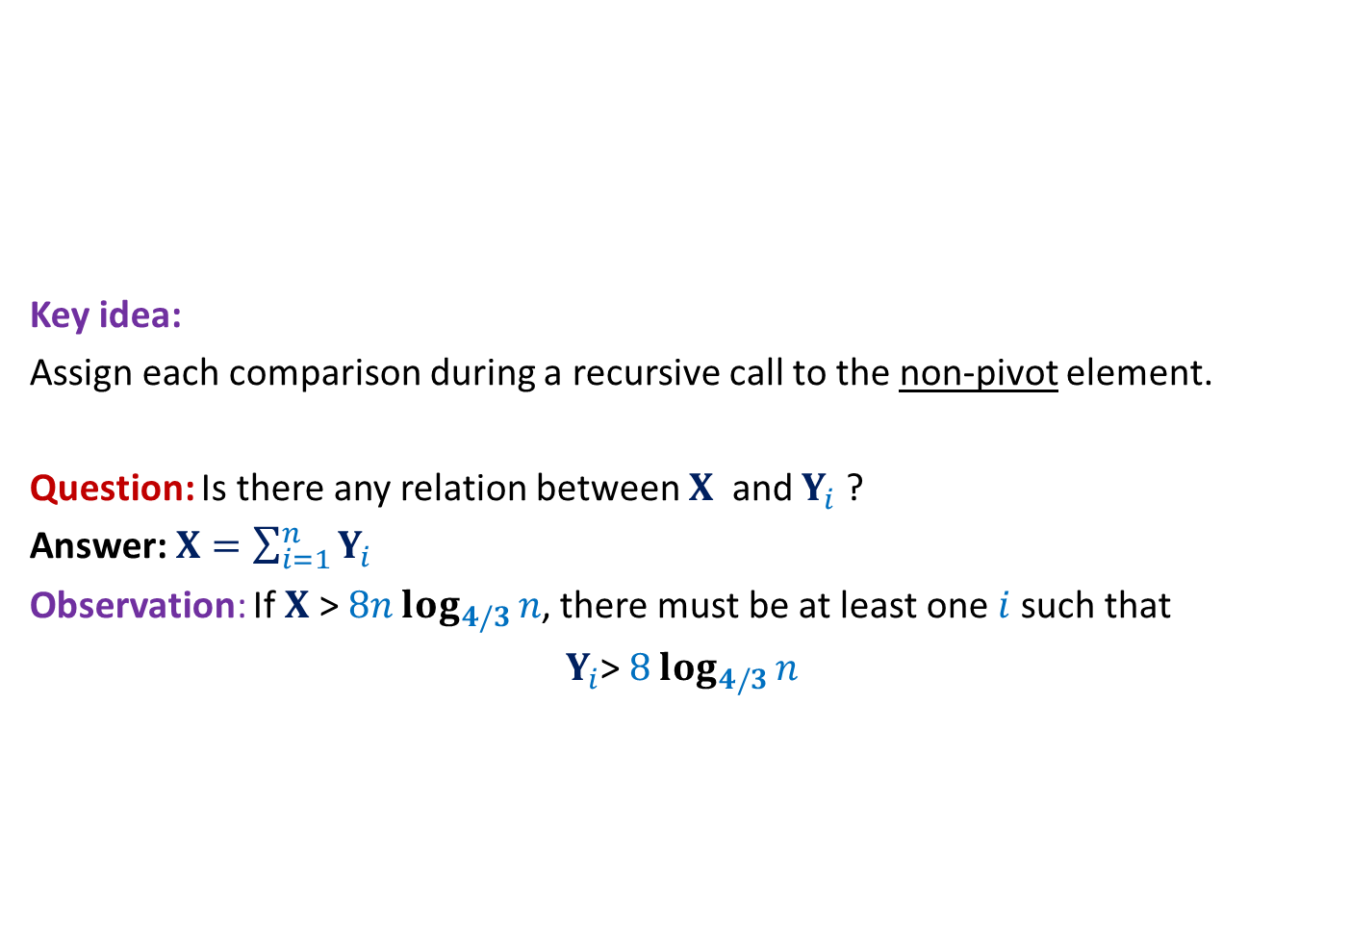
Randomized QuickSort A new way to count the comparisons
Elements of A arranged in Increasing order of values
Key idea:
Assign each comparison during a recursive call to the non-pivot element.
Question: Is there any relation between $X$ and $Y_{i}$ ?
Answer: $X=\sum_{i=1}^{n}{Y_{i}}$
Observation: If $X$ > $8nlog_{4/3}{n}$, there must be at least one $i$such that
$Y_{i}$> $8log_{4/3}{n}$

Slide 15

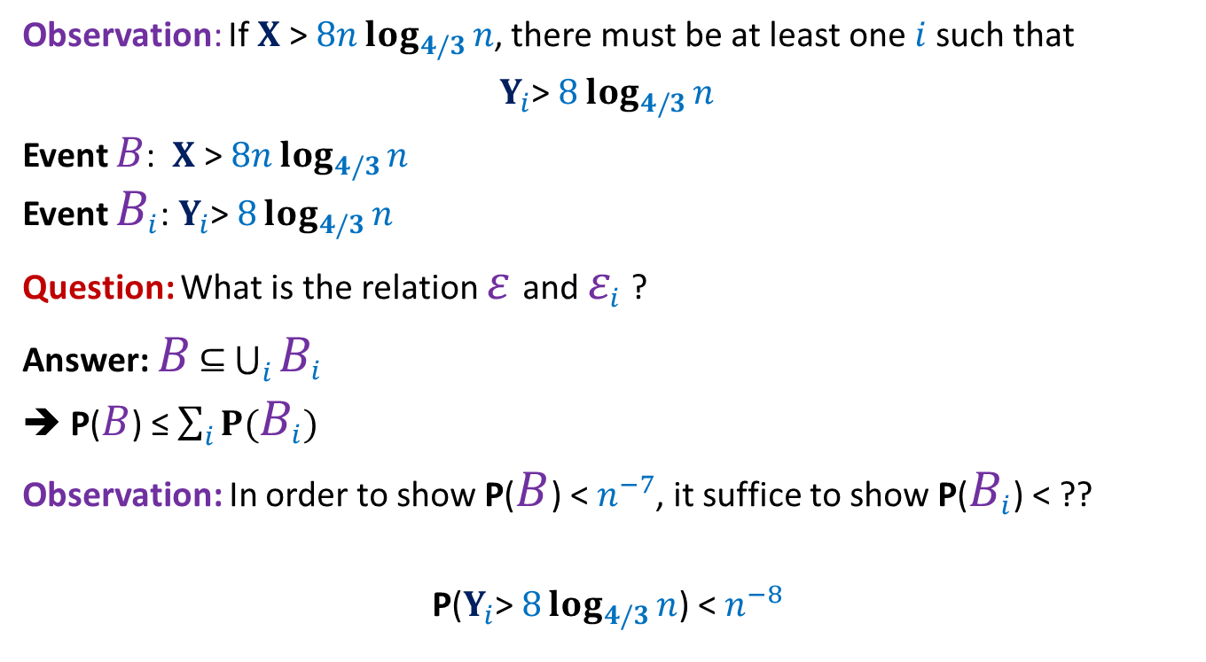
Randomized QuickSort Applying Union theorem
Observation: If $X$ > $8nlog_{4/3}{n}$, there must be at least one $i$such that
$Y_{i}$> $8log_{4/3}{n}$
Event $B$: $X$ > $8nlog_{4/3}{n}$
Event $B_{i}$: $Y_{i}$> $8log_{4/3}{n}$
Question: What is the relation $ε$and $ε_{i}$ ?
Answer: $B$ $⊆$ $\bigcup_{i}{B_{i}}$
➔ P($B$) ≤ $\sum_{i}{P(B_{i})}$
Observation: In order to show P($B$) < $n^{−7}$, it suffice to show P($B_{i}$) < ??
P($Y_{i}$> $8log_{4/3}{n}$) < $n^{−8}$
$$n^{−8}$$

Slide 16
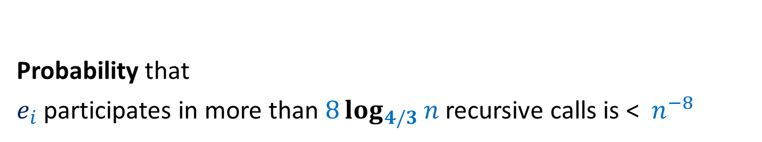

AIM: To show P($Y_{i}$> $8log_{4/3}{n}$) < $n^{−8}$
Probability that
$e_{i}$ participates in more than $8log_{4/3}{n}$ recursive calls is < $n^{−8}$

Slide 17

Randomized Quick Sort
from perspective of $e_{i}$
Recursion Tree
$$e_{i}$$
Size of $i$th recursive call

Slide 18

An Attempt
Show that
With high probability, size of $i$th recursive call < $\frac{n}{c^{i}}$ for some constant $c>1$

Slide 19

Randomized Quick Sort
from perspective of $e_{i}$
Recursion Tree
$$e_{i}$$
Size of $i$th recursive call
depends upon the $i−1$ pivots

Slide 20

A Brilliant Idea
Increasing order of values
Definition:
a recursive call is good if the pivot is selected from the middle half,
and bad otherwise.
P(a recursive call is good) = ??
Notation: The size of a recursive call is the size of the subarray it sorts.
…
middle-half
$$\frac{1}{2}$$

Slide 21
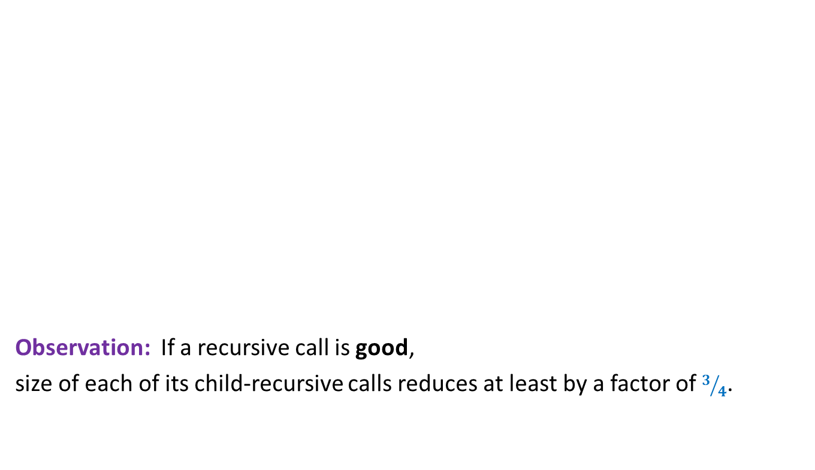
A Brilliant Idea
Increasing order of values
Observation: If a recursive call is good,
size of each of its child-recursive calls reduces at least by a factor of $3/4$.
…
middle-half

Slide 22

A Brilliant Idea
$$e_{i}$$
Increasing order of values
Question: What is the maximum no. of good recursive calls $e_{i}$can have in its lifetime?
Answer: $log_{4/3}{n}$.
…
middle-half

Slide 23

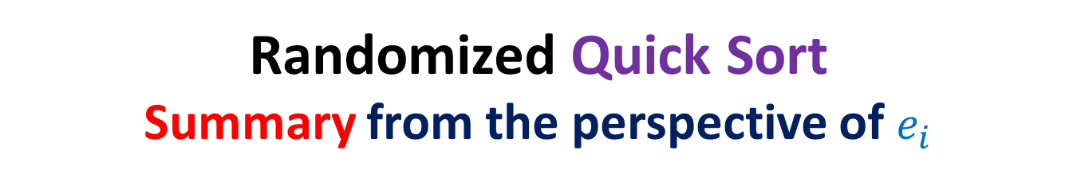
Randomized Quick Sort Summary from the perspective of $e_{i}$
During Randomized Quick Sort,
$e_{i}$Participates in a sequence of recursive calls
each of which is good independently with probability $1/2$.
$e_{i}$ leaves algorithm on or before participating in $log_{4/3}{n}$ good recursive calls.
$B_{i}$: $e_{i}$ participated in more than $8 log_{4/3}{n}$ recursive calls
With this insight, can you express this event in terms of any coin tossing event ?

Slide 24




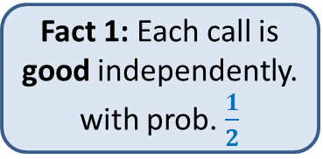
Randomized Quick Sort:
Recursive calls in which $e_{i}$appears
Fact 1: Each call is good independently. with prob. $\frac{1}{2}$
Our insight revealed two facts.
…
Fact 2: $e_{i}$ disappears on or before $log_{4/3}{n}$ good calls
…
$$8 log_{4/3}{n}$$
P[$e_{i}$ appears in more than $8 log_{4/3}{n}$ calls]

Slide 25
Randomized Quick Sort:
Recursive calls in which $e_{i}$appears
Good
Bad
…
Now relate it to some coin tossing experiment.
…
Make an attempt. ☺
$$8 log_{4/3}{n}$$
P[$e_{i}$ appears in more than $8 log_{4/3}{n}$ calls]

Slide 26


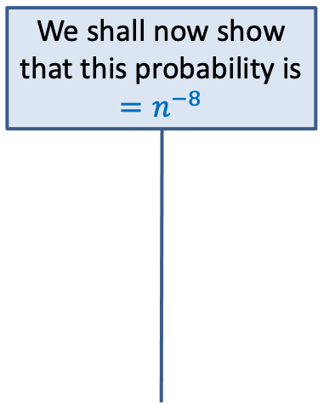

Randomized Quick Sort:
Recursive calls in which $e_{i}$appears
Experiment 1:
We toss a fair coin and
stop on getting $log_{4/3}{n}$ heads
T
T
Good
Bad
H
…
T
…
We shall now show that this probability is $=n^{−8}$
…
…
H
$$8 log_{4/3}{n}$$
T
$$≤$$
P[$e_{i}$ appears in more than $8 log_{4/3}{n}$ calls]
P[more than 8 $log_{4/3}{n}$ tosses are made]

Slide 27


Experiment 1:
Tossing a fair coin till we get $log_{4/3}{n}$ heads
P[more than $8 log_{4/3}{n}$ tosses are made]
Experiment 2:
Tossing a fair coin $8 log_{4/3}{n}$ times
P[less than $log_{4/3}{n}$ heads]
?
Intuitively the two probabilities look same.
However, the difficulty in establishing their equality arises since
the two sample spaces are different.
We can get rid of this difficulty by designing an experiment
that captures the essence of both the experiments.

Slide 28
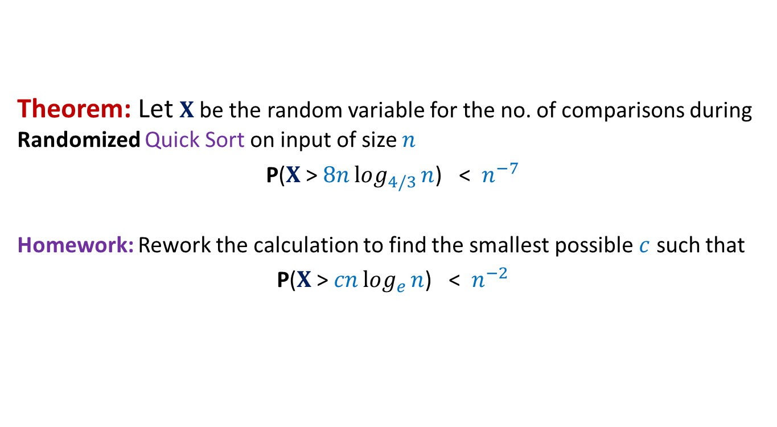
Randomized Quick Sort Final result
Theorem: Let $X$be the random variable for the no. of comparisons during Randomized Quick Sort on input of size $n$
P($X$ > $8nlog_{4/3}{n}$) < $n^{−7}$
Homework: Rework the calculation to find the smallest possible $c$ such that
P($X$ > $cnlog_{e}{n}$) < $n^{−2}$

Slide 29

Randomized Algorithms
How does one go about designing a randomized algorithm ?

Slide 30
Randomized Algorithms
Some random idea is required to design a randomized algorithm.
Let us carefully look at the randomized algorithms discussed till now.

Slide 31
Randomized Quick Sort

Slide 32

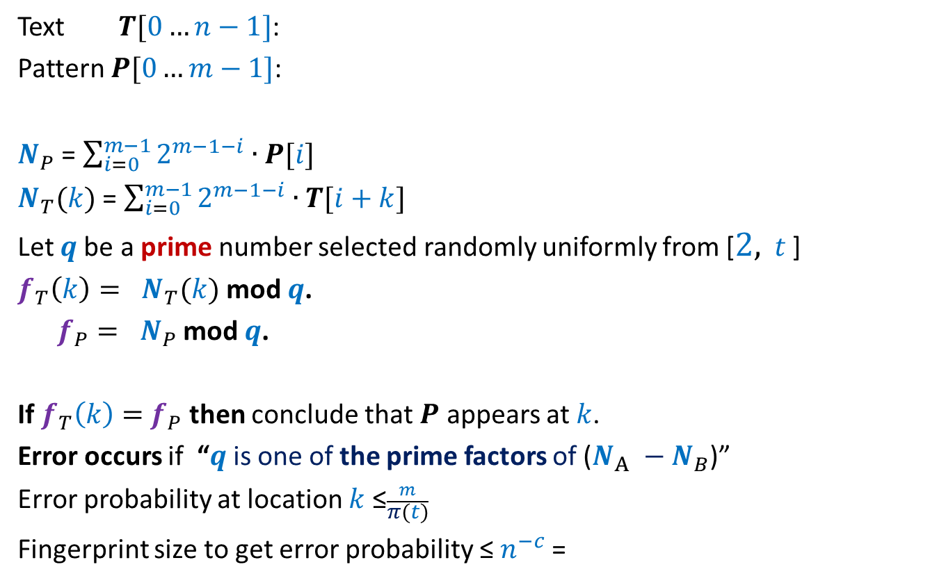
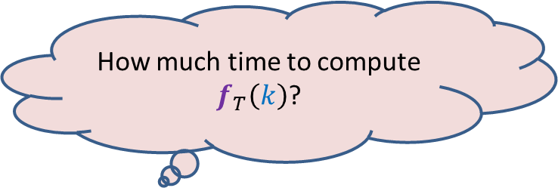

Randomized Quick Sort
$1$ …
$$n$$
A
Elements of A arranged in Increasing order of values
pivot
$$n/4$$
$${3n}/4$$

Slide 33

Randomized Quick Sort
Observation: There are many elements in A that are good pivot.
Is it possible to select one good pivot efficiently ?
(not possible deterministically ☹)
We select pivot element randomly uniformly.
A randomly selected element is a good pivot with probability $\frac{1}{2}$

Slide 34
Randomized Algorithm for Approximate median

Slide 35
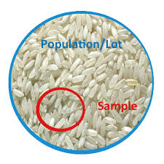
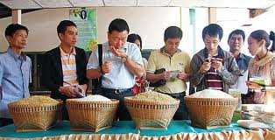
Randomized Algorithm for Approximate median
A random sample captures the essence of the original population.

Slide 36
Randomized Algorithm for Approximate median
Idea: Is it possible to select a small sample of elements
whose median approximates the median ?
(not possible deterministically ☹)
Median of a uniformly random sample will be approximate median w.h.p.
A random sample captures the essence of the original population.

Slide 37
Checking Equality of Files
By transmitting least number of bits

Slide 38






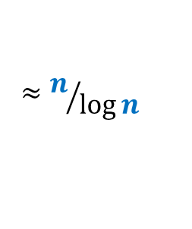
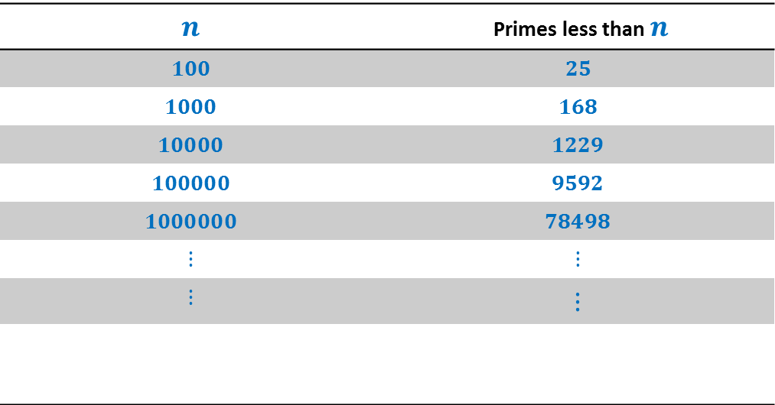

How many primes less than $n$ ?
$$n$$ | Primes less than $n$
$$100$$ | $$25$$
$$1000$$ | $$168$$
$$10000$$ | $$1229$$
$$100000$$ | $$9592$$
$$1000000$$ | $$78498$$
$$⋮$$ | $$⋮$$
$$⋮$$ | $$⋮$$
$π\left(n\right)$:
$$π\left(n\right)$$
$$≈n/{\log{n}}$$
Huge gap
How many prime factors of $n$ ?
$$<\log{n}$$
Observation:
Majority of prime numbers from a [2, $c \log^{2}⁡$ $n$]
are unlikely to be a prime factor of $n$
Notes:
Randomization will exploit this huge difference to achieve a very simple and elegant algorithm.

Slide 39
Randomized Algorithms
An idea based on insight into the problem
Difficult/impossible to exploit the idea deterministically
A randomized algorithm
Randomization to materialize the idea
The following slide conveys a very important message.

Slide 40

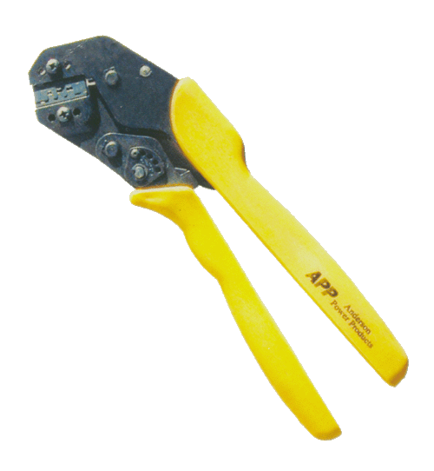
Randomization
Greedy strategy
Dynamic programming
Divide and conquer
Tools for designing algorithms
But what matters the most in designing an efficient algorithm is …
INSIGHT of a problem

Slide 41
Frievald’s Technique Application matrix product verification
Homework:
What is the key idea ?
How does randomization help to materialize it ?

Slide 42
Approximate Distance oracles

Slide 43
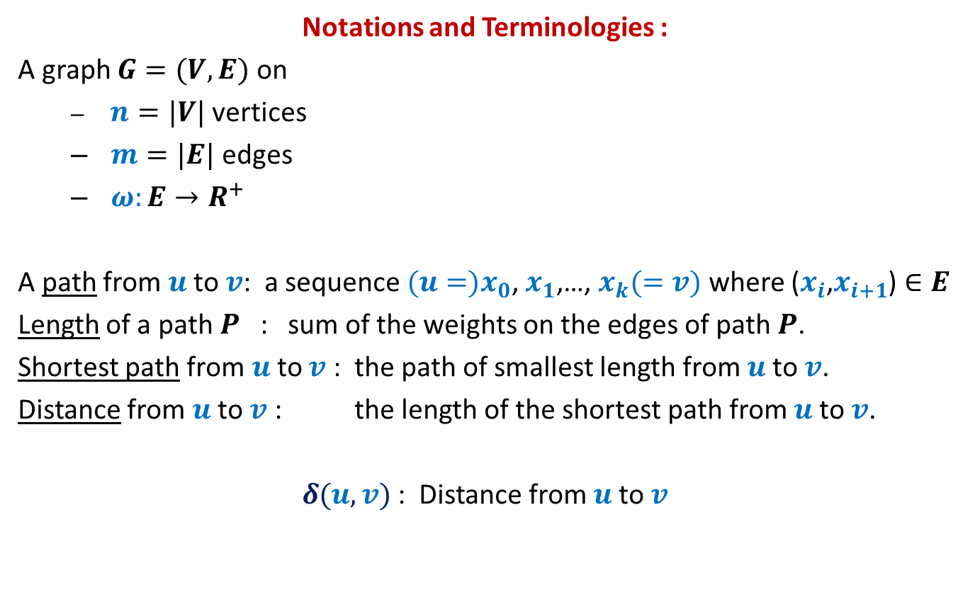
All-Pairs Shortest Paths
Notations and Terminologies :
A graph $G=(V,E)$ on
$n=|V|$ vertices
$m=|E|$ edges
$ω:E→R^{+}$
A path from $u$to $v$: a sequence ${(u=)x}_{0}$, $x_{1}$,…, $x_{k}(=v)$ where ($x_{i}$,$x_{i+1}$) $∈E$
Length of a path $P$ : sum of the weights on the edges of path $P$.
Shortest path from $u$to $v$ : the path of smallest length from $u$to $v$.
Distance from $u$to $v$ : the length of the shortest path from $u$to $v$.
$δ(u,v)$ : Distance from $u$to $v$

Slide 44
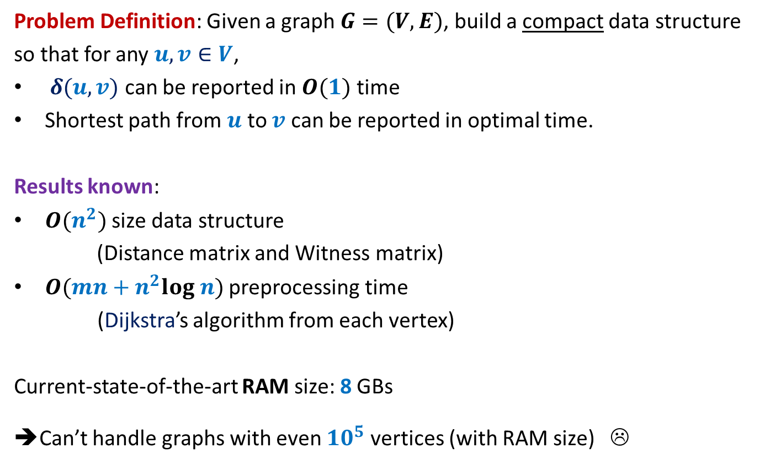
All-Pairs Shortest Paths
Problem Definition: Given a graph $G=(V,E)$, build a compact data structure
so that for any $u,v∈V$,
$δ(u,v)$ can be reported in $O(1)$ time
Shortest path from $u$ to $v$ can be reported in optimal time.
Results known:
$O(n^{2})$ size data structure
(Distance matrix and Witness matrix)
$O(mn+n^{2}log n)$ preprocessing time
(Dijkstra’s algorithm from each vertex)
Current-state-of-the-art RAM size: 8 GBs
➔Can’t handle graphs with even ${10}^{5}$ vertices (with RAM size) ☹

Slide 45
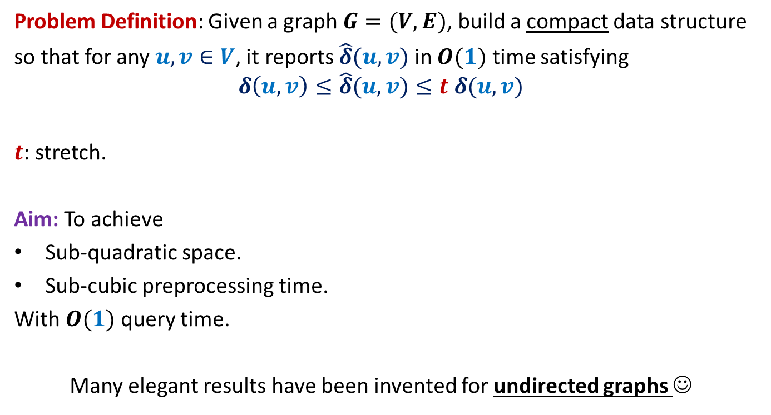
All-Pairs Approximate Shortest Paths
Problem Definition: Given a graph $G=(V,E)$, build a compact data structure
so that for any $u,v∈V$, it reports $\hat{δ}(u,v)$ in $O(1)$ time satisfying
$$δ\left(u,v\right)≤\hat{δ}(u,v)≤t δ(u,v)$$
$t$: stretch.
Aim: To achieve
Sub-quadratic space.
Sub-cubic preprocessing time.
With $O(1)$ query time.
Many elegant results have been invented for undirected graphs ☺

Slide 46





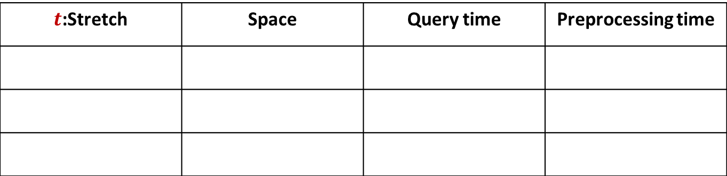







A truly magical result
Approximate Distance Oracles
$t$:Stretch | Space | Query time | Preprocessing time
$$3$$
$$O(n^{1+\frac{1}{2}})$$
$$O(1)$$
$$O({mn}^{\frac{1}{2}})$$
$$5$$
$$O(n^{1+\frac{1}{3}})$$
$$O(1)$$
$$O({mn}^{\frac{1}{3}})$$
$$2k−1$$
$$O(n^{1+\frac{1}{k}})$$
$$O(k)$$
$$O({k mn}^{\frac{1}{k}})$$
Mikkel Thorup and Uri Zwick:
Approximate Distance Oracles for graphs,
Journal of ACM (4), 2005

Slide 47
Inspiration from our daily life

Slide 48
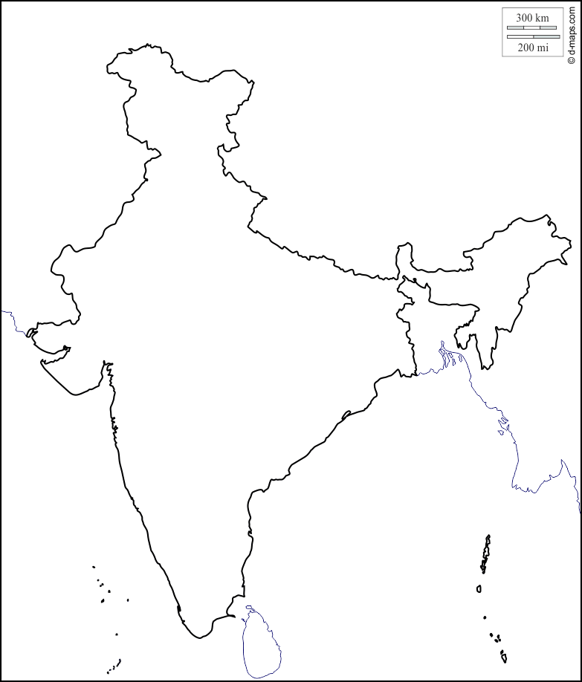

Key insight underlying Approximate Distance Oracle
$$Kanpur$$

Slide 49





Key insight underlying Approximate Distance Oracle
$$Rohtak$$
$$Lucknow$$
$$Delhi$$
$$Kanpur$$
$$Fatehpur$$

Slide 50

Idea to achieve subquadratic space
$$V$$

Slide 51


Idea to achieve subquadratic space
Since |$L$| is small, ➔
we can afford to store distance from each $u∈L$ to every other vertex.
From each vertex $u∈V\backslash L$,
store distance to vertices present in its locality
$$L$$
. . . . . . . . . .
$$V$$

Slide 52

Formal notion of locality
$$u$$

Slide 53



Formal notion of locality
$Ball(u,V,L)$= {$x∈V| δ\left(u,x\right)<δ\left(u,L(u)\right)$}
$$L(u)$$
$$u$$
$$Ball(u,V,L)$$

Slide 54

The Idea
Given a graph $G=(V,E)$,
Compute a small set $L$ of Landmark vertices.
From each vertex $u∈V\backslash L$, store distance to vertices present in its locality.
From each vertex $v∈L$, store distance to all vertices in the graph.
Questions:
What is the formal notion of locality ?
How to retrieve distance from $u$ to a far away vertex ?
What is the guarantee of stretch ?
How to compute the desired set $L$ efficiently ?

Slide 55





Reporting distance from $u$
Report $δ\left(u,L(u)\right)+δ\left(L(u),v\right)$
$$δ\left(u,L(u)\right)≤δ\left(u,v\right)$$
$$v$$
$$v$$
$$L(u)$$
$$u$$
$$Ball(u,V,L)$$

Slide 56



What is the stretch ?
stretch $≤3$
$$δ\left(u,L(u)\right)≤δ\left(u,v\right)$$
??
$$≤δ\left(u,v\right)+δ\left(u,L(u)\right)$$
$≤2δ\left(u,v\right)$
$$v$$
$$L(u)$$
$$u$$
$$Ball(u,V,L)$$

Slide 57
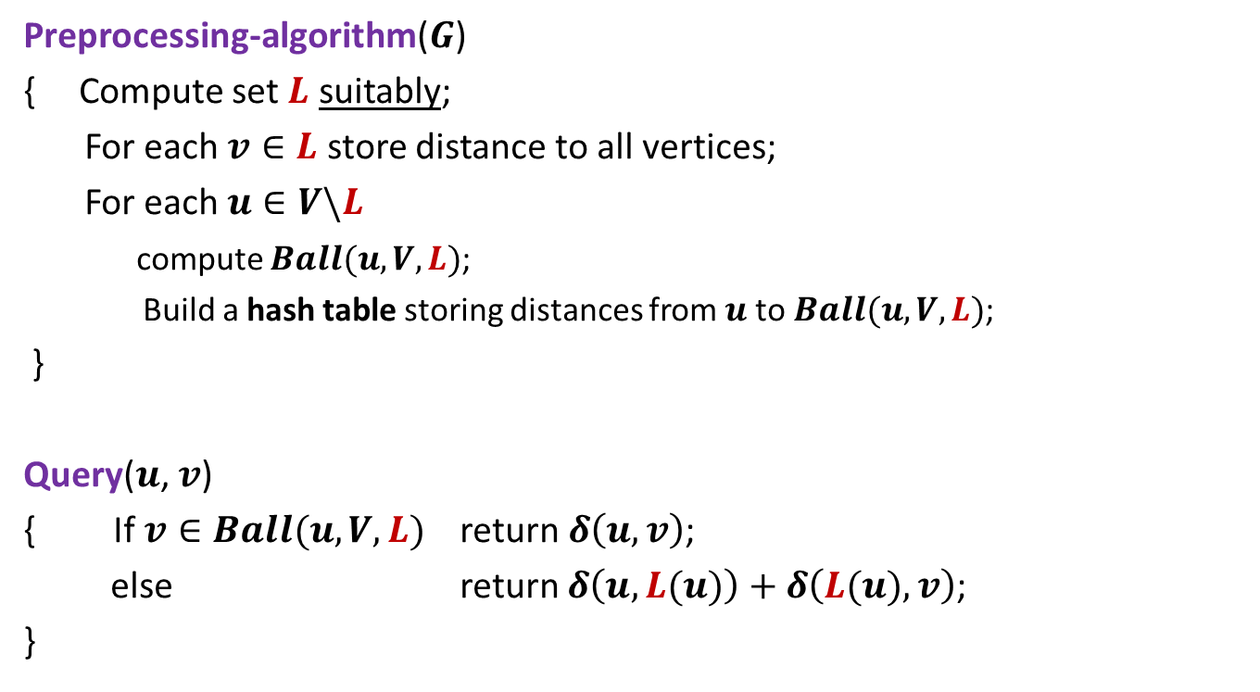
3-approximate distance oracle
Preprocessing-algorithm($G$)
{ Compute set $L$ suitably;
For each $v∈L$ store distance to all vertices;
For each $u∈V\backslash L$
compute $Ball(u,V,L)$;
Build a hash table storing distances from $u$to $Ball(u,V,L)$;
}
Query($u$, $v$)
{ If $v∈Ball(u,V,L)$ return $δ\left(u,v\right)$;
else return $δ\left(u,L(u)\right)+δ\left(L(u),v\right)$;
}
Global distance info.
Local distance info.

Slide 58
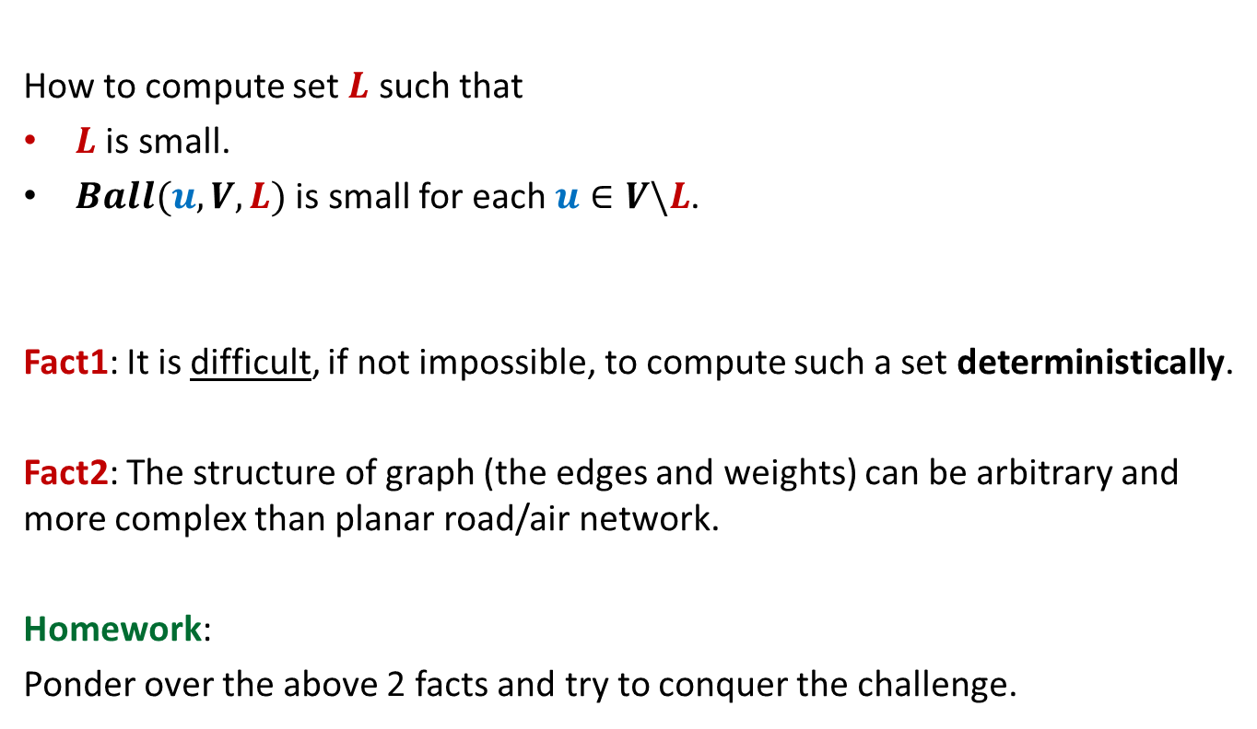
The real challenge left
How to compute set $L$ such that
$L$ is small.
$Ball(u,V,L)$ is small for each $u∈V\backslash L$.
Fact1: It is difficult, if not impossible, to compute such a set deterministically.
Fact2: The structure of graph (the edges and weights) can be arbitrary and more complex than planar road/air network.
Homework:
Ponder over the above 2 facts and try to conquer the challenge.

